Slide 1
MASS VIGILANT SYSTEM
Project Guide:
G.Siva Shankar, M.Tech
Assistant Professor,
Department of IT
Team Associates:
M.Chandrika(16A91A1208)
Ch.V Vijay Krishna(16A91A1209)
K.Vikhyatha Babu(16A91A1222)
K.Dharmendra Reddy(16A91A1206)

Slide 2
Introduction
The main objective of this project is to reduce the manual work in finding supicious activities.
Everyday actions are increasingly being handled by electronically, instead of finding suspicious activities through manually.

Slide 3
Applications
Polling Booths.
Hospitals.
ATM’S.

Slide 4
Hardware Requirements
4 GB RAM
i3 or above version processor
780p HD camera for better Resolution

Slide 5
Software Requirements
Front end(IDE) : Visual Studio2010
Server Side Technology : Python Flask
Languages : Python Open CV, HTML5,Java Script
Backend(database) : MySQL
Working Platform
Operating System : Windows 10

Slide 6
Functional Requirements
Must be connected to Network
Crowd Identification
API, to send alert

Slide 7
Non Functional Requirements
Availability
Reusability
Updatability

Slide 8
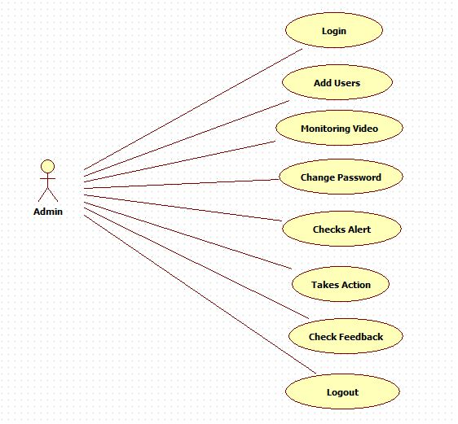
UML Diagrams
Use case diagram(Admin):

Slide 9
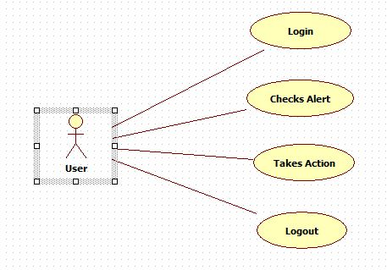
Use case diagram(User):

Slide 10
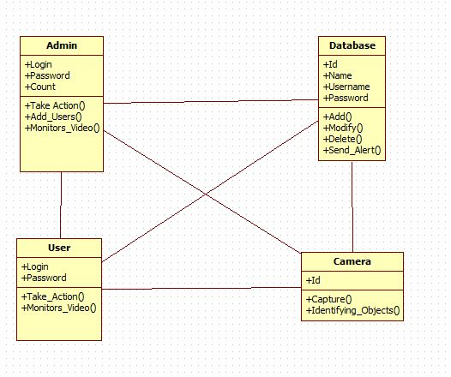
Class Diagram:

Slide 11
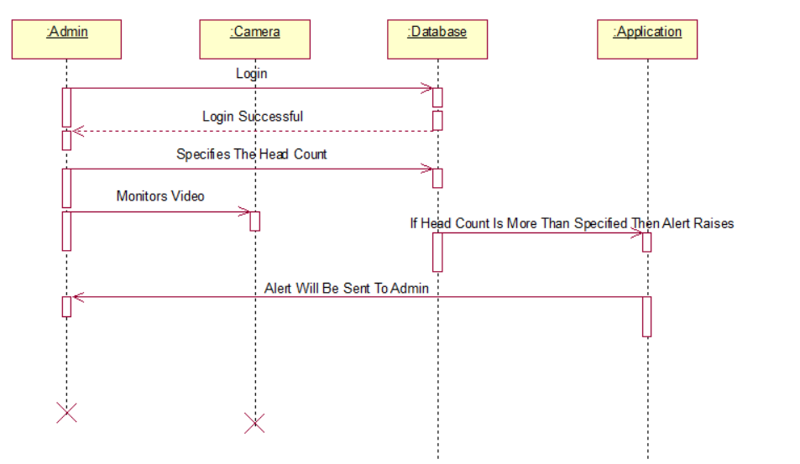
Sequence Diagram:

Slide 12
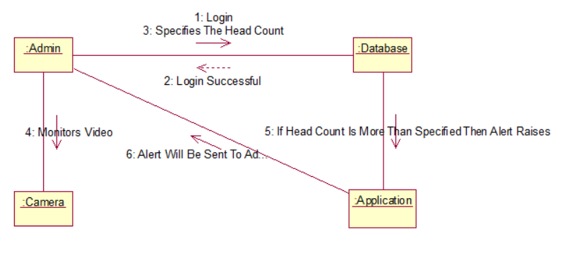
Collaboration Diagram:

Slide 13
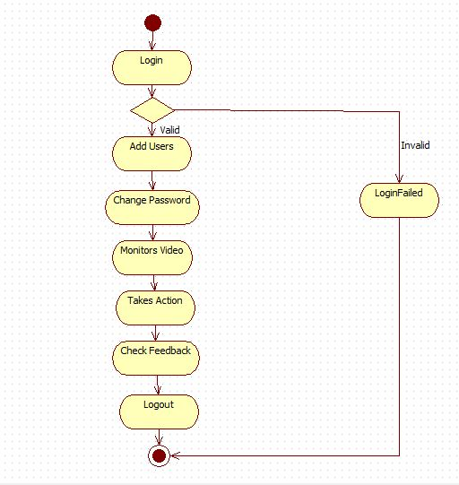
Activity Diagram(Admin):

Slide 14
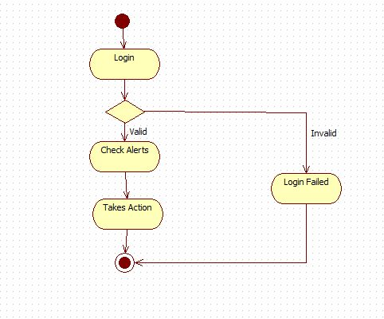
Activity Diagram(User):

Slide 15
PROCESS
Firstly,the admin will have to register.
After registration the admin will have to login to the website.
The admin dash board will contain Add user,vigilance,feedback report and password change options.
The admin will log in by using his credentials and he will redirected to his dashboard

Slide 16
PROCESS Contn
The users also can login by using there log in credentials given by the admin.
The camera will detect the no of faces and if the count is more than the specified then an alarm will raises.
The admin or User will respond manually by after looking into video.
The users can also give the feedback to the the admin.

Slide 17
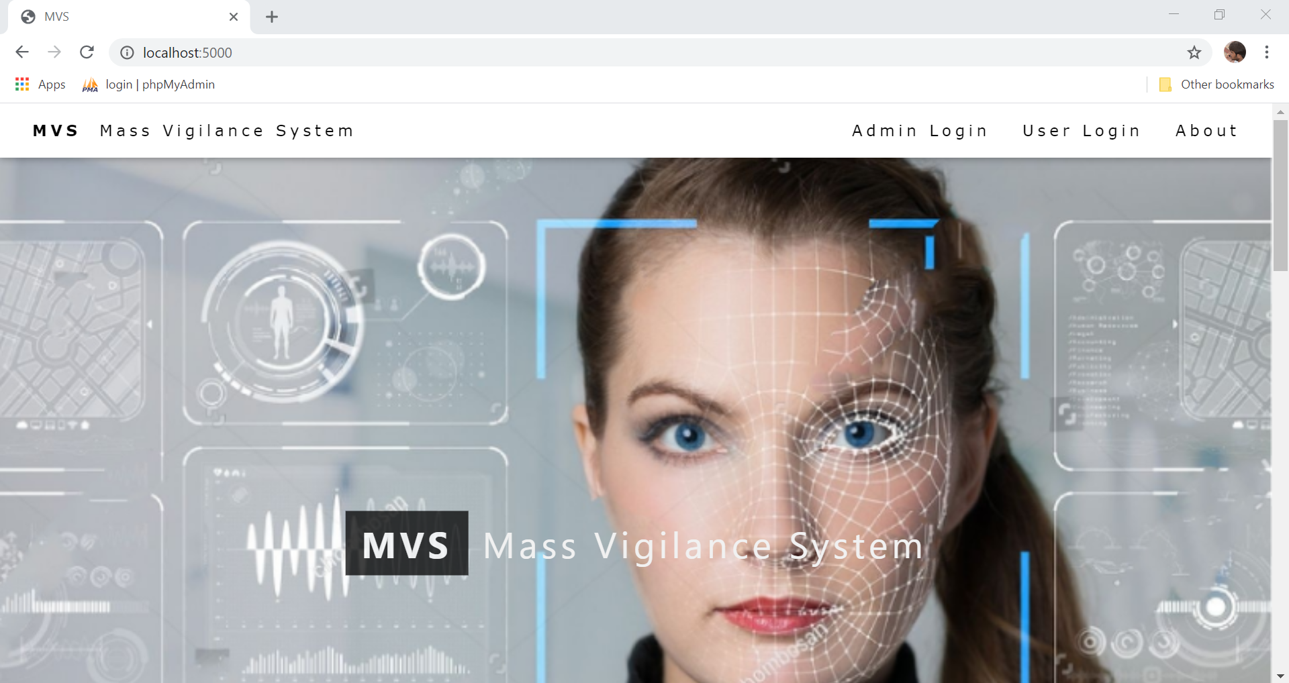
Screenshots
Home Screen

Slide 18
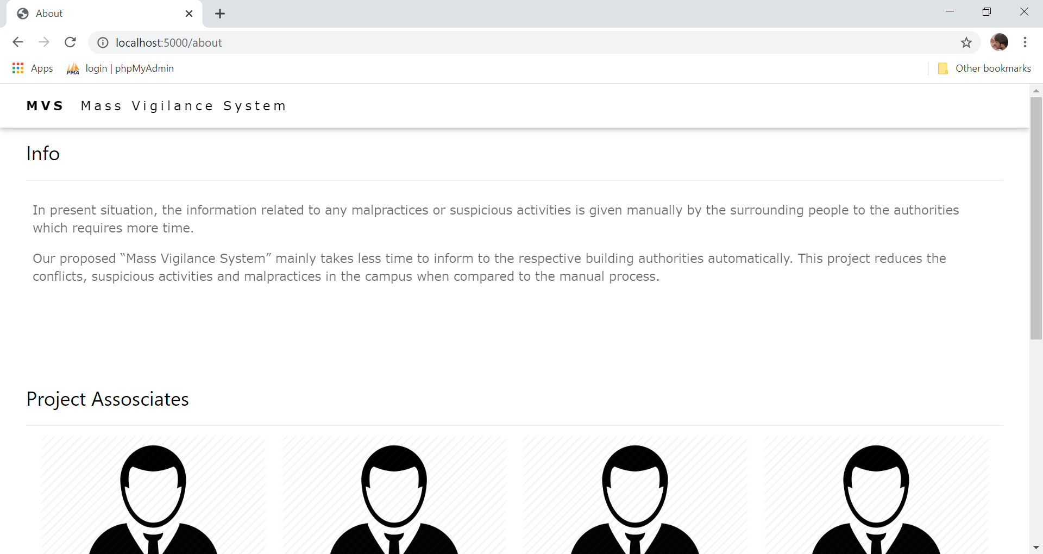
About Project

Slide 19
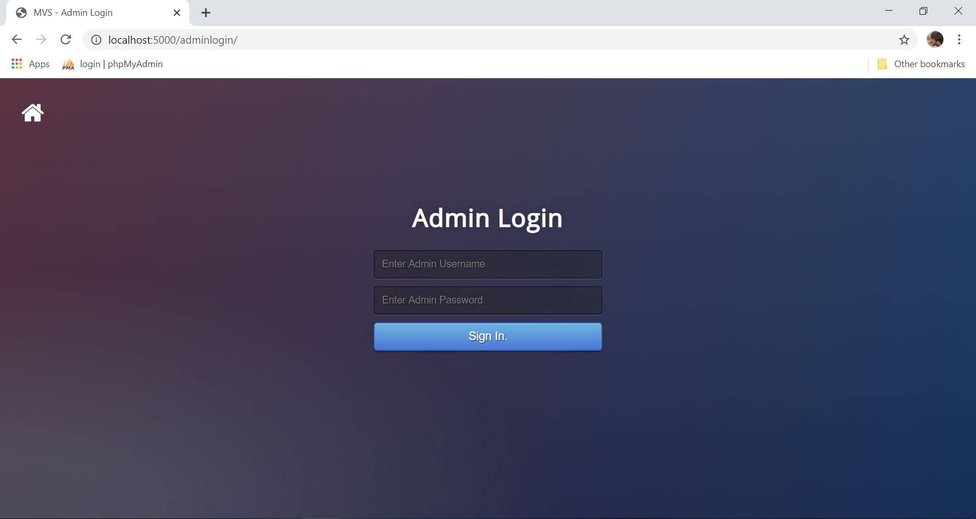
Admin Login

Slide 20
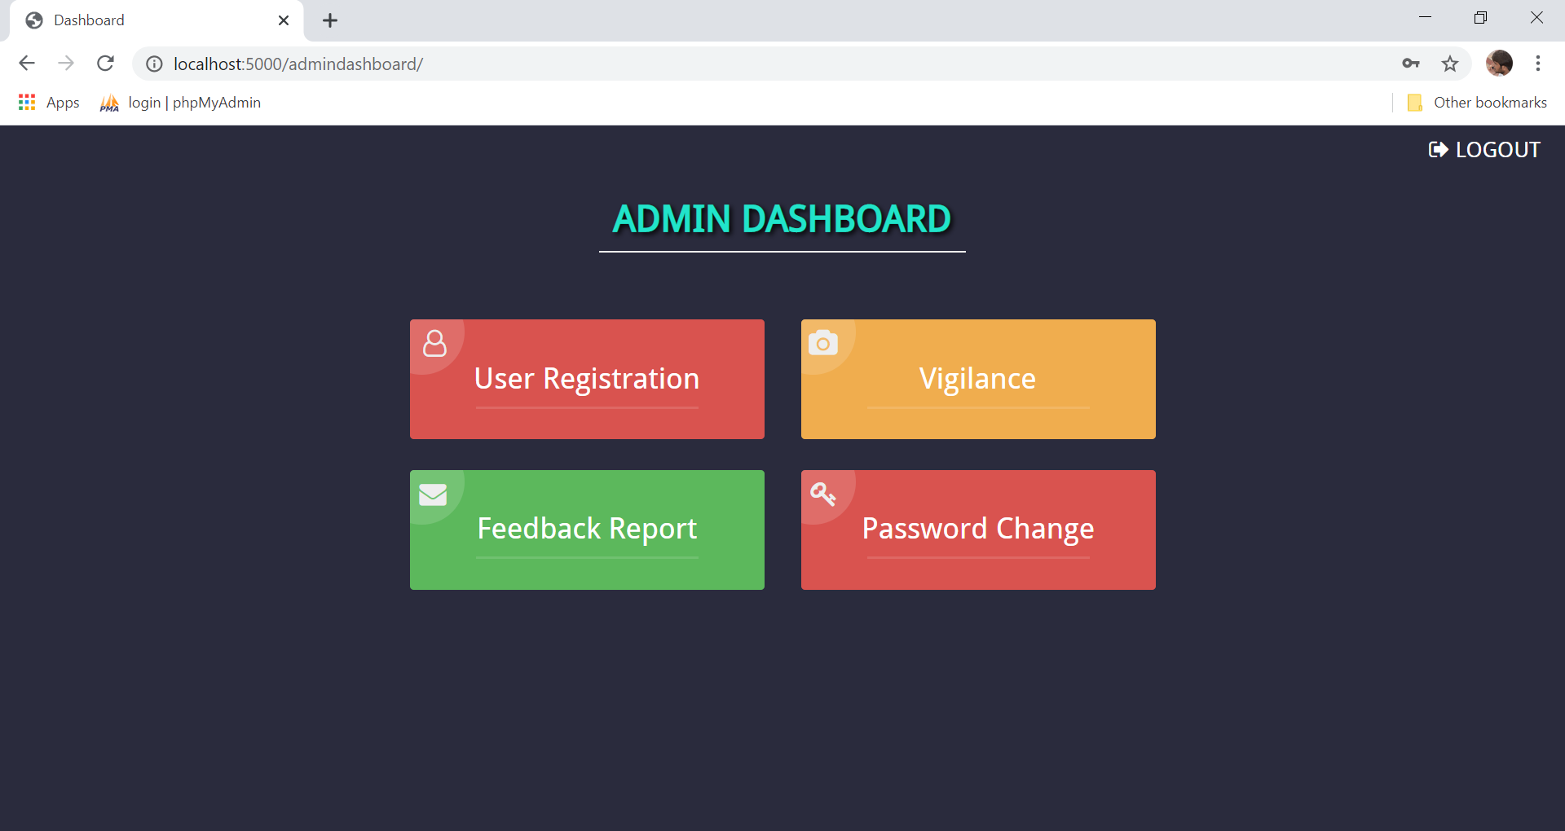
Admin Dashboard

Slide 21
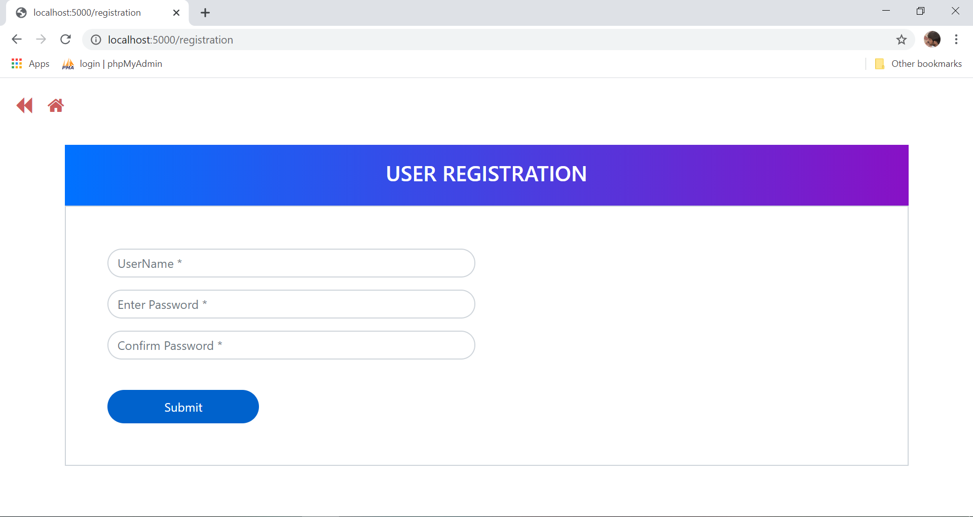
User Registration

Slide 22

User Login

Slide 23
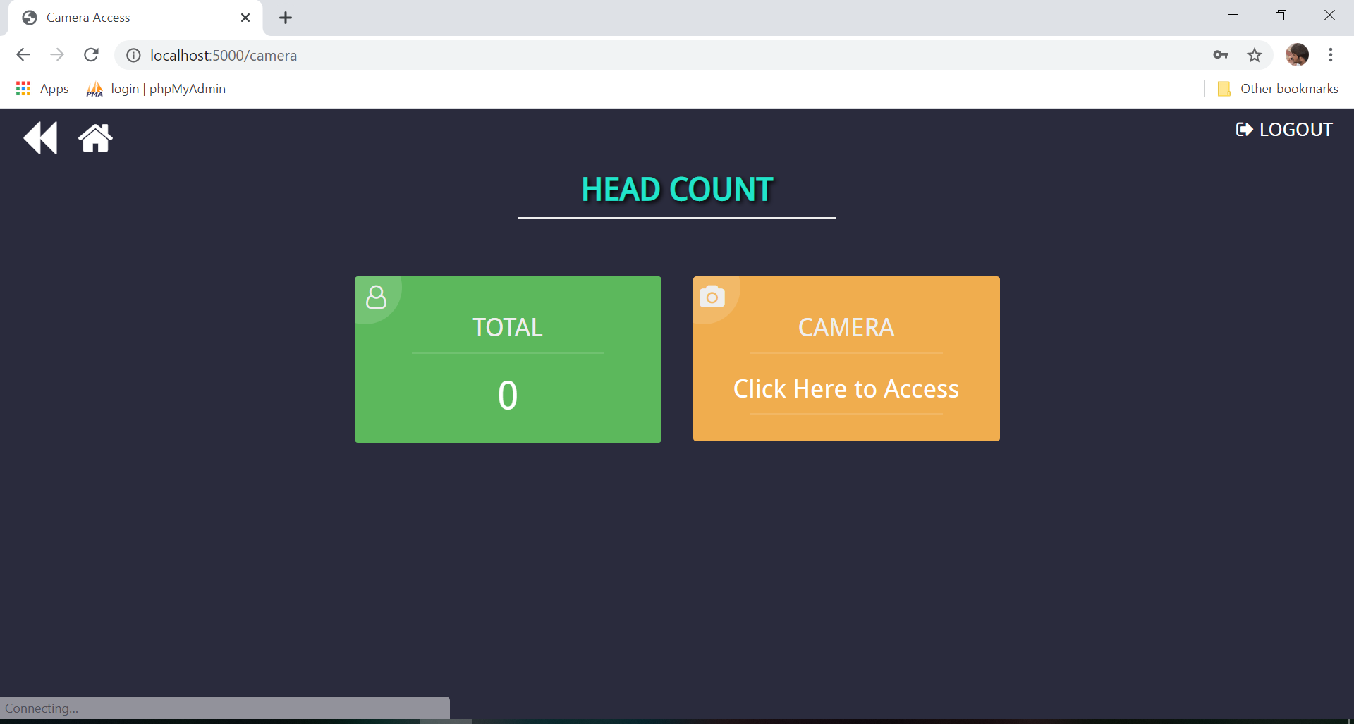
User Dashboard

Slide 24
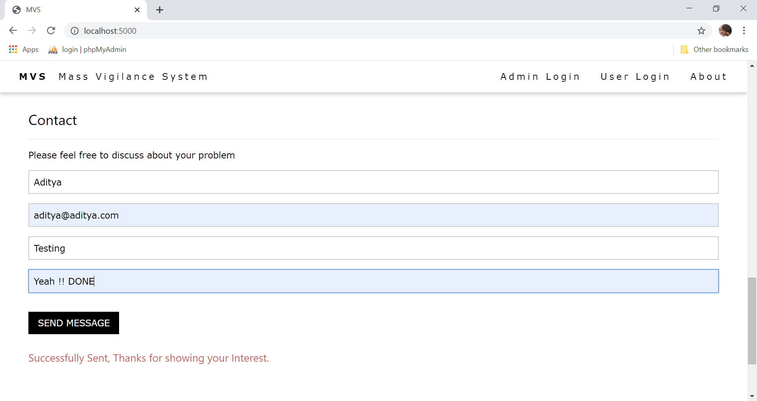
Feedback Form

Slide 25
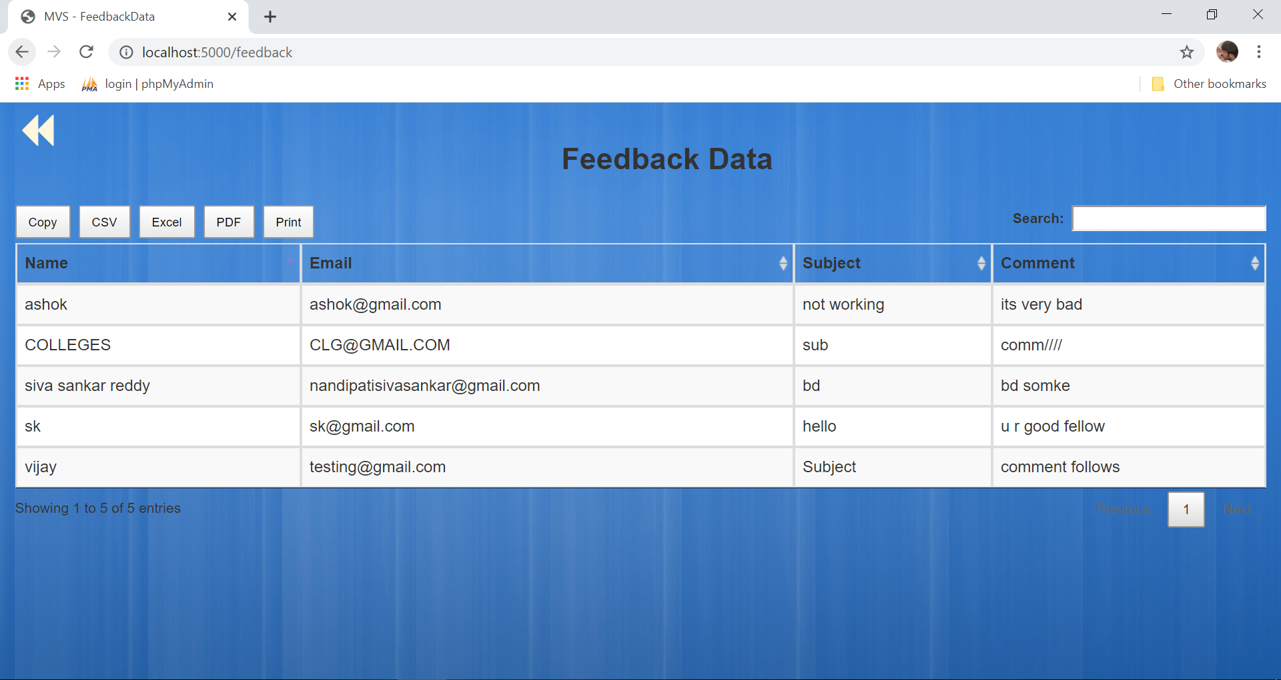
Feedback Data

Slide 26
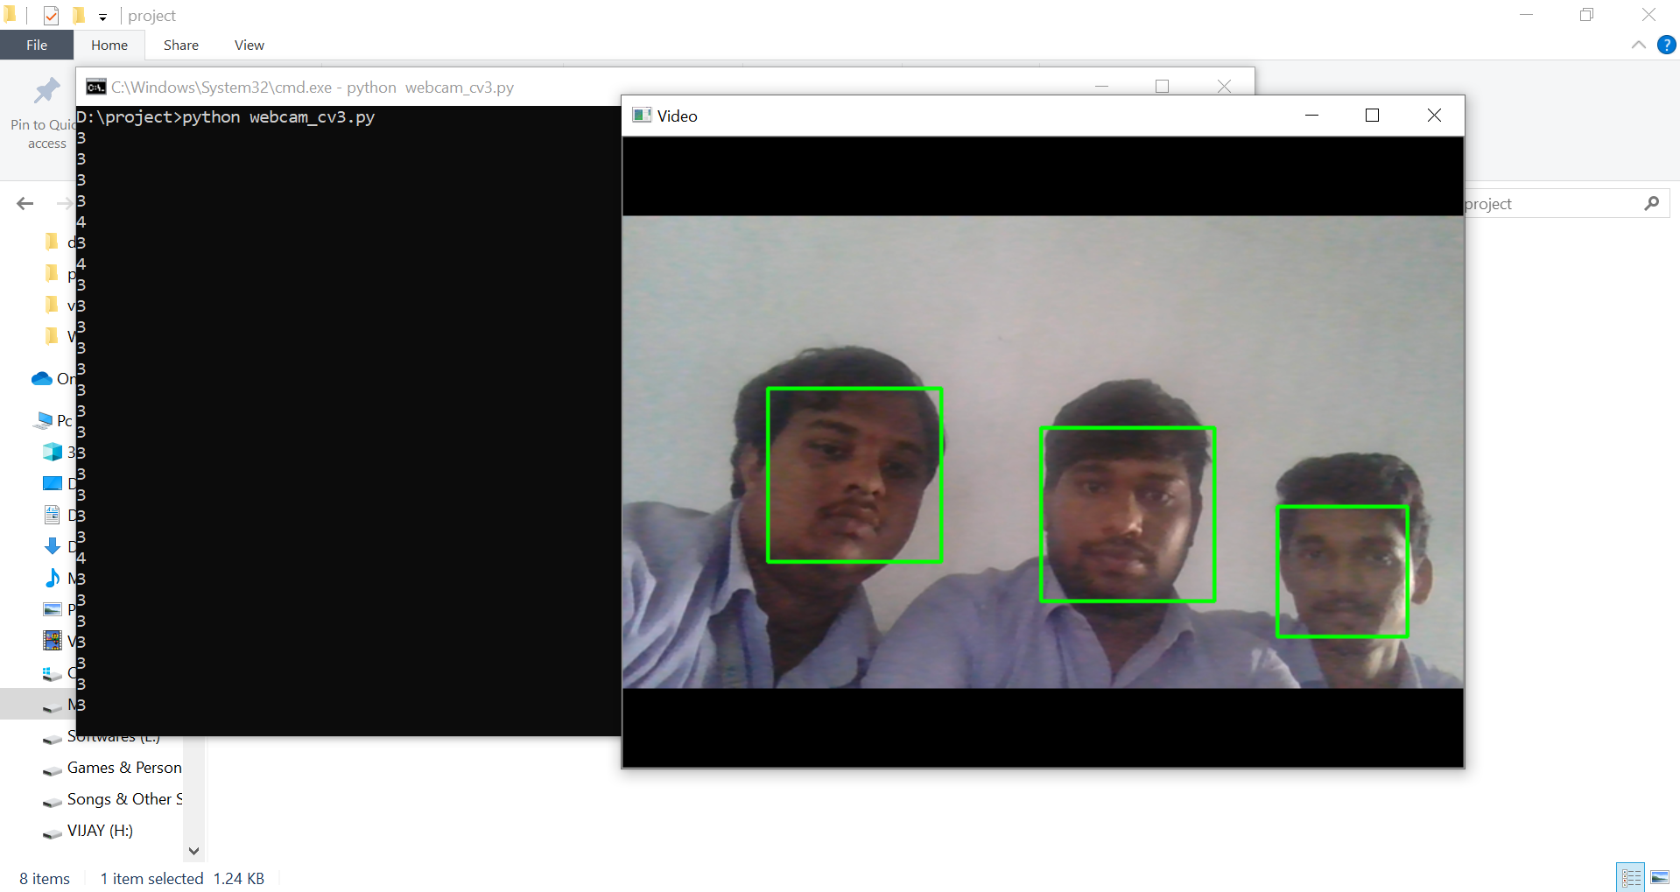
Face Recogniton and Counting No.of.Faces

Slide 27

Any Queries….!!!

Slide 28
Thank you….!!!

